Slide 1
PHONEBOOK MANAGEMENT SYSTEM
prepared BY
MUHAMMAD OWAIS QADRI (519-2020)
MUHAMMAD JAHANGIR (791-2017)
SUBMITTED TO: SIR ABID ALI

Slide 2
INTRODUCTION
This simple mini project in C creates an external file to store the user's data permanently to perform file handling operations. Phonebook is an extremely straightforward small undertaking in C that can assist you with understanding the fundamental ideas of capacities, record taking care of, and information structure. This application will show you how to include, list, change or alter, look and erase information to/from the record.

Slide 3
LIBRARIES USED IN THIS PROJECT
#include <stdio.h>------->stdio.h is a header file which has the necessary information to include the input/output related functions in our program.
#include <stdlib.h>The stdlib.h header defines four variable types, several macros, and various functions for performing general functions.
#include <string.h>The string.h header defines one variable type, one macro, and various functions for manipulating arrays of characters.
#include <conio.h>It is a header file used in c and cpp and it includes inbuilt functions like getch() and clrscr().

Slide 4
FUNCTIONS THAT ARE USED IN THIS PROJECT
void add_contact(): -------> It's a utility function to add a contact into the directory
void search_contact(): -------> It's a utility function to search for a contact
void modify_contact(): -------> It's a utility function to modify a contact
void display(): -------> It's a utility function to display all contacts within the directory
int directory_info(): -------> It's a utility function to find out the total no.of contacts in the directory
void display_by_tag(): -------> It's a utility function to display all the contacts with the specified tag
int tag_info(): -------> It's a utility function to find out the total no.of contacts that are saved in specified tag
void delete_contact(): -------> It's a utility function to delete a contact from the directory

Slide 5
CODE OF THIS PROJECT
#include <stdio.h>
#include <stdlib.h>
#include <string.h>
#include <conio.h>
struct contact{
char fname[15];
char lname[15];
char mobile_no[15];
char tag[15];
};
typedef struct contact contact;

Slide 6
CONT…
// A utility function to add contact into the directory
void add_contact()
{
system("cls");
FILE *fptr;
contact cn;
fptr = fopen("PhoneBook","a");
printf("\n<Fill details>\n");
printf("Enter First Name : ");
scanf("%s", &cn.fname);

Slide 7
CONT…
printf("Enter last Name : ");
scanf("%s", &cn.lname);
printf("\nEnter Mobile Number : ");
scanf("%s", &cn.mobile_no);
printf("\nEnter Tag(Enter 'Other' for nothing) : ");
scanf("%s", &cn.tag);
fwrite(&cn, sizeof(contact), 1, fptr);
fclose(fptr);
printf("Enter any key to continue.");
getch();
system("cls"); }

Slide 8
CONT…
// A utility function to print the no.of contacts in the directory
int directory_info(){
FILE *fptr;
fptr = fopen("PhoneBook", "r");
fseek(fptr, 0, SEEK_END);
return ftell(fptr)/sizeof(contact);
}
// A utility function to know how many contacts are saved within a specified tag in the directory
return num;
}

Slide 9
CONT…
int tag_info(char tag[])
{
int num = 0;
FILE *fptr;
contact cn;
fptr = fopen("PhoneBook", "r");
while(fread(&cn, sizeof(contact), 1, fptr)) {
if(strcmp(strlwr(cn.tag), strlwr(tag)) == 0)
num++;
}

Slide 10
CONT…
//A utility function to display the contacts
void display(){
system("cls");
FILE *fptr;
contact cn;
int mode, count = 1, i, n;
fptr = fopen("PhoneBook", "r");
printf("1 : View by Time Created (Ascending)\n");
printf("2 : View by Time Created (Descending)\n");
printf("Choose Display Mode : ");
scanf("%d", &mode);

Slide 11
CONT…
n = directory_info();
printf("---------------------------------------------------------------------\n");
printf("|Total Number of contacts : %2d |\n",n);
printf("---------------------------------------------------------------------");
printf("\n|%-3s| %-15s%-15s%-20s%-12s|\n", "Sno", "First Name", "Last Name", "Contact Number", "Tag");
printf("---------------------------------------------------------------------");

Slide 12
CONT…
if(mode == 1) {
while(fread(&cn, sizeof(contact), 1, fptr)) {
printf("\n|%-3d| %-15s%-15s%-20s%-12s|", count++, cn.fname, cn.lname, cn.mobile_no, cn.tag); } }
else if (mode == 2) {
fseek(fptr,-(sizeof(cn)), SEEK_END);
for(i = 1; i <= n; ++i) {
fread(&cn, sizeof(contact), 1, fptr);
printf("\n|%-3d| %-15s%-15s%-20s%-12s|", count++, cn.fname, cn.lname, cn.mobile_no, cn.tag);
fseek(fptr, -2*sizeof(contact), SEEK_CUR); } }

Slide 13
CONT…
else
printf("\n|Invalid Selection !!! |");
printf("\n---------------------------------------------------------------------\n");
fclose(fptr);
printf("\n\nEnter any key to continue : ");
getch();
system("cls");}
//This is a utility function which displays all the contacts which are saved within a specified tag
void display_by_tag(){
system("cls");

Slide 14
CONT…
char tag[20]; FILE *fptr; contact cn;
int count=1, n; fptr = fopen("PhoneBook", "r");
fflush(stdin);
printf("Enter Tag : ");
scanf("%s", tag);
n = tag_info(tag);
printf("---------------------------------------------------------------------\n");
printf("|Total Number of contacts : %2d |\n", n);
printf("---------------------------------------------------------------------");
printf("\n|%-3s| %-15s%-15s%-20s%-12s|\n", "Sno", "First Name", "Last Name", "Contact Number", "Tag");
printf("---------------------------------------------------------------------");

Slide 15
CONT…
while(fread(&cn, sizeof(contact), 1, fptr)) {
if(strcmp(strlwr(cn.tag), strlwr(tag)) == 0)
printf("\n|%-3d| %-15s%-15s%-20s%-12s|", count++, cn.fname, cn.lname, cn.mobile_no, cn.tag); }
printf("\n---------------------------------------------------------------------\n");
fclose(fptr);
fflush(stdin);
printf("\n\nEnter any key to continue : ");
getch();
system("cls");}

Slide 16
CONT…
A utility function to modify a cotact
void modify_contact(){ system("cls");
FILE *fptr, *fptr1;contact cn;
char fname[15]; char lname[15];char modify; int found = 0;
fptr = fopen("PhoneBook", "r");
fptr1 = fopen("helper", "w");
printf("Enter the name of Contact to modify:\n");
printf("Enter First name: "); scanf("%s",&fname);
printf("Enter Last name: "); scanf("%s",&lname);
fflush(stdin);

Slide 17
CONT…
while(fread(&cn,sizeof(contact),1,fptr)) {
if(strcmp(strlwr(cn.fname),strlwr(fname))==0&&strcmp(strlwr(cn.lname),strlwr(lname))==0) { found = 1;
printf("\nModify First Name?<y/n> : ");
scanf("%c", &modify);
fflush(stdin); if(modify == 'y' || modify == 'Y') {
printf("Enter New First name : "); scanf("%s", &cn.fname);
fflush(stdin); }
printf("\nModify Last Name?<y/n> : "); scanf("%c", &modify);
fflush(stdin); if(modify == 'y' || modify == 'Y') {
printf("Enter New Last name : "); scanf("%s", &cn.lname);
fflush(stdin); }

Slide 18
CONT…
printf("\nModify Mobile Number? <y/n> : ");
scanf("%c", &modify);
fflush(stdin);
if(modify == 'y' || modify == 'Y') {
printf("Enter New Mobile Number : ");
scanf("%s", &cn.mobile_no);
fflush(stdin); }
printf("\nModify Tag? <y/n> : ");
scanf("%c", &modify);
fflush(stdin);
if(modify == 'y' || modify == 'Y') {

Slide 19
CONT…
printf("Enter New Tag : ");
scanf("%s", &cn.tag);
fflush(stdin); } }
fwrite(&cn, sizeof(contact), 1, fptr1); } fclose(fptr);
fclose(fptr1);
if(found == 1)
{
fptr1 = fopen("helper", "r");
fptr = fopen("PhoneBook", "w");
while(fread(&cn, sizeof(contact), 1, fptr1))
fwrite(&cn, sizeof(contact), 1, fptr);
printf("\nContact Modified Successfully\n"); }

Slide 20
CONT…
else
printf("Contact not found");
fclose(fptr); fclose(fptr1);
printf("\n\nEnter any key to continue : "); getch();
system("cls");}
//A utility function to search for the info of a specified contact
void search_contact(){ system("cls");
FILE *fp; contact cn; int c,flag=0;
fp=fopen("PhoneBook","r");
if(fp==NULL){ printf("\nError in opening\n");
exit(1);}

Slide 21
CONT…
printf("\n------------------------------------\n"); printf("***SEARCH MENU***\n"); printf("----------------------------------------\n");
printf("1. Search by name\n2. Search by Phone number\n"); printf("Enter your choice : ");
scanf("%d",&c); fflush(stdin);
if(c==1){ char fname[30],lname[30];
printf("Enter the name to be searched for:\n");
printf("Enter first name : "); scanf("%s",&fname);
printf("Enter last name : ");
scanf("%s",&lname);
fflush(stdin);
while(fread(&cn,sizeof(cn),1,fp)==1){

Slide 22
CONT…
if(strcmp(strlwr(cn.fname),strlwr(fname))==0&&strcmp(strlwr(cn.lname),strlwr(lname))==0){
flag=1;
printf("\nDetail information about %s\n",fname);
printf("---------------------------------------------------------------------\n");
printf("\n|%-15s%-15s%-20s%-12s|\n", "First Name", "Last Name", "Contact Number", "Tag");
printf("---------------------------------------------------------------------");
printf("\n|%-15s%-15s%-20s%-12s|\n", cn.fname, cn.lname, cn.mobile_no, cn.tag);
break; } }
if(flag==0){
printf("\nSearch not found\n");
fclose(fp);}}
else if(c==2){

Slide 23
CONT…
char phone[10];
printf("Enter phone number to search: ");
scanf("%s",&phone);
while(fread(&cn,sizeof(cn),1,fp)==1){
if(strcmp(phone,cn.mobile_no)==0){
flag=1;
printf("\n\nDetail information about %s",phone);
printf("---------------------------------------------------------------------\n");
printf("\n|%-15s%-15s%-20s%-12s|\n", "First Name", "Last Name", "Contact Number", "Tag");
printf("---------------------------------------------------------------------");
printf("\n|%-15s%-15s%-20s%-12s|\n", cn.fname, cn.lname, cn.mobile_no, cn.tag);
break; }}

Slide 24
CONT…
if(flag==0) {
printf("\nSearch not found\n");
fclose(fp);
}}
else{
printf("Wrong Choice!!");
fclose(fp);
}
printf("Enter any key to continue:");
getch();
system("cls");}

Slide 25
CONT…
//A utility function to delete a contact from the directory
void delete_contact(){
contact cn;
FILE *fptr,*fptr1;
int flag;
system("cls");
fptr=fopen("PhoneBook","r");
if(fptr==NULL){
printf("CONTACT'S DATA NOT ADDED YET");
}
else{ fptr1=fopen("helper","w+");

Slide 26
CONT…
if(fptr1==NULL)printf("Error in opening the file");
else{
int choice;
printf("\n----------------------------------------");
printf("\n***DELETION MENU***\n");
printf("----------------------------------------\n");
printf("1.Deletion through mobile number\n2.Deletion through name\n");
printf("Enter your choice: "); scanf("%d",&choice);

Slide 27
CONT…
if(choice==1){
char mobile_no[25];
printf("Enter CONTACT's mobile_no:");
scanf("%s",&mobile_no);
fflush(stdin);
while(fread(&cn,sizeof(cn),1,fptr)==1){
if(strcmp(mobile_no,cn.mobile_no)!=0){
fwrite(&cn,sizeof(cn),1,fptr1);
}
if(strcmp(mobile_no,cn.mobile_no)==0){
flag=1; }}}

Slide 28
CONT…
else if(choice==2){
char fname[25],lname[25];
printf("Enter CONTACT's fname: ");
scanf("%s",&fname);
printf("Enter CONTACT's lname: ");
scanf("%s",&lname);
fflush(stdin);
while(fread(&cn,sizeof(cn),1,fptr)==1){

Slide 29
CONT…
if(strcmp(strlwr(cn.fname),strlwr(fname))!=0||strcmp(strlwr(cn.lname),strlwr(lname))!=0){
fwrite(&cn,sizeof(cn),1,fptr1);}
if(strcmp(strlwr(cn.fname),strlwr(fname))==0&&strcmp(strlwr(cn.lname),strlwr(lname))==0){
flag=1;
} }
}else{
printf("\nWrong choice!\nEnter any key to continue");
getch();
system("cls");}

Slide 30
CONT…
fclose(fptr); fclose(fptr1);
if(flag!=1){ printf("NO CONTACT'S RECORD TO DELETE!\n");}
else{
fptr1 = fopen("helper", "r");
fptr = fopen("PhoneBook", "w");
while(fread(&cn, sizeof(contact), 1, fptr1))
fwrite(&cn, sizeof(contact), 1, fptr);
printf("\nContact Deleted Successfully\n"); }
fclose(fptr1);
fclose(fptr);}}
printf("Enter any key:");
getch(); system("cls");}

Slide 31
CONT…
//Driver code
int main(){
int operation = 1;
while(operation) {
printf("\n1 : Create Contact\n"); printf("2 : Display Directory\n");
printf("3 : Display by tags\n");
printf("4 : Modify Contact\n");
printf("5 : Search Contact\n");
printf("6 : Delete Contact\n");
printf("7 : Exit Program\n");
printf("\nChoose Operation : "); scanf("%d", &operation);

Slide 32
CONT…
switch(operation) {
case 1 : add_contact(); break;
case 2 : display(); break;
case 3 : display_by_tag(); break;
case 4 : modify_contact(); break;
case 5: search_contact(); break;
case 6: delete_contact(); break;
case 7:
exit(1);
break;

Slide 33
CONT…
default: system("cls");
printf("\nInvalid Operation !!");
printf("\nEnter 1 to 7 only");
printf("\n Enter any key to continue");
getch();
system("cls");
}
}
return 0;
}

Slide 34
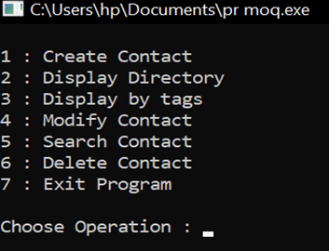
RESULTS

Slide 35
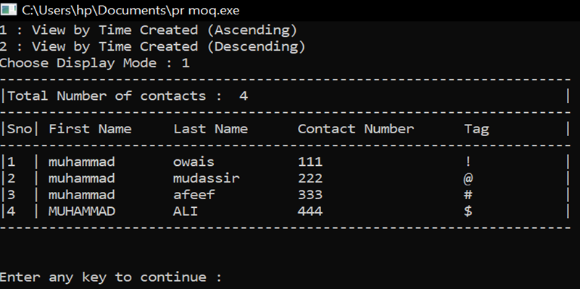
CONT…

Slide 36
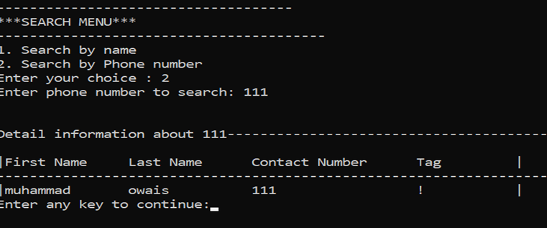
CONT…

Slide 37
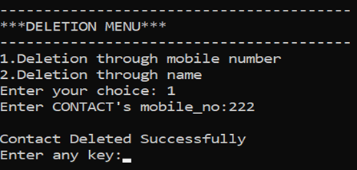
CONT…

Slide 38
Conclusion
This Phonebook application is one of the simplest mini projects developed by the Code with C team.
I hope this mini project on Phonebook application in C will help you as a reference project to understand file handling, data structure and functions. (File handling and data structure have been effectively used for the last five functions aforementioned.)

Slide 39
……….END……….

